Slide 1
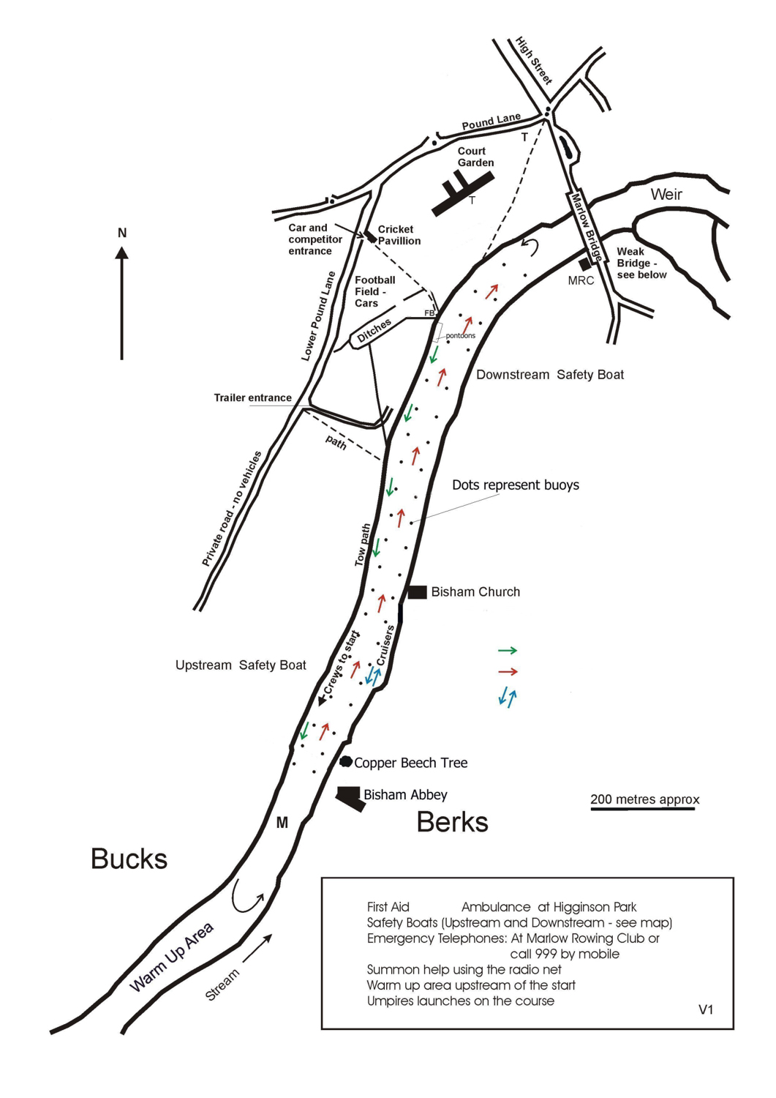
Marlow Mini-regatta
15 June 2024
Course Map
U
RC
R
Turn at
YELLOW buoy
Finish
FB Footbridge
M Marshall
Registration
RC Race Control
U Umpires
First Aid
Drop Off Point
Regatta Enclosure
R
Adaptive
Start
Crews proceeding to the start
Crews Racing
Navigation Channel
Start

Slide 2
Marlow Mini-regatta
15 June 2024
Course Map
START AREA DETAIL
Bisham Church
Bucks
UPSTREAM SAFETY LAUNCH
Start
Align
Pick-up
Marshall Area
Bisham Abbey
Sailing School
Berks
Warm-up
WARNING
Navigation Channel MUST be kept clear
Crews racing
Crews heading to the start

